Slide 1

Team NERDS: Tackling the challenge of recruiting more diverse candidates into nursing—by taking recruiting to the streets.

Slide 2






The Need for Recruiting Diverse Talent to Nursing Escalated trends already in place
Severe nursing shortage
Lack of nursing school enrollment & educators
Changing population demographics
High turnover rates
19.2% of nurses are people of color
9.1% of the nursing workforce is male
https://www.aacnnursing.org/news-information/fact-sheets/nursing-shortage
https://www.aacnnursing.org/Portals/42/News/Factsheets/Enhancing-Diversity-Factsheet.pdf
3.04 Team NERDS
Notes:
There are several trends in the healthcare and life science that were accelerated significantly by the COVID pandemic of 2020. These include virtual health, virtual work and school, remote assist, use of artificial intelligence in HLS, virtual clinical trials and development and deployment of vaccines.
Virtual Health –
Prior to COVID-19, movement to virtual health was a slow, steady progression forward - overcoming obstacles such as payment barriers (especially in reimbursement models by private and government payors), medical licensure standards and ability to practice across state lines, and patient/physician preference (and need) for in-person exams. Over the past few years, companies like Teladoc and MDLive have forged ahead with new business models and platforms that were of high interest to employers and some payor organizations. With the pandemic, virtual visits went from less than one percent of visits to well over 30% percent of visits by July/August of 2020. While there has been some decline it seems clear that virtual visits are here to stay leveling off around 10%. In parallel with virtual visits, we have seen a move to a more comprehensive virtual health process that includes managing care across the continuum including using remote monitoring to augment patient reported data. We have also seen an expansion of the digital front door serving patients with easy to access medical content, credible triage and guided recommendations. It was not just virtual patient visits that saw a significant escalation but virtual rounding and virtual caregiver collaboration in general saw an uptick with physicians working 2 – 3 days a week from home.
Virtual Work & School – hybrid model, virtual conferencing, remote access, health equity. Baseline testing on a regular basis. Return to School - Huge problem for equity – front line works hurt economically. At home inexpensive testing. Community positive rates and zones affect back to school. Test surrounding communities. US Davis study. Schools then community and genomic testing. Direct outreach.
Remote Assist – virtual bio-medical support, rural care
We see a strong move to remote and mobile assist in many of our partners including med Tech and companies like Nuance in the voice dictation space.
Augmented reality superimposes digital content, such as 3-D images or visual instructions, onto a user’s view of the real world. Since March, Sheba Medical Center has used five HoloLens 2 headsets to train about 60 physicians, biomedical engineers and nurses on how to operate ventilators for Covid-19 patients.
Artificial Intelligence – AI\ML has been a source of optimism in HLS for several years. The pandemic is showing us that the benefits of artificial intelligence (AI) applied to health and medicine are undeniable: dashboarding rates, testing, vaccination and vulnerable communities, using AI to calculate the numbers of citizens in each vaccination priority category and using health bots to scale consumer support for answers, freeing clinicians to focus on care while maintaining high levels of consumer satisfaction. 2021 is expected to be a year where health systems make unprecedented investments in AI to improve quality, reduce costs, and create more personalized experiences for patients and health consumers alike.
Virtual Clinical Trials – Modernizing clinical trials has been a theme for the past few years in the BioPharma Industry. Decentralized clinical trials is a term that has evolved over time and represents a continuum of virtual health components that may be incorporated into the clinical trial. Importantly, the term allows for flexibility within the industry managing multiple clinical trials at any given time to leverage the appropriate set of applications and platform tools fit for purpose to the specific clinical trial and the preference of engagement of each patient participating in a clinical trial. With the pandemic we saw the streamlining of research and development including ways to reduce the time in each of the three phases of clinical trials without reducing safety. We fully expect that the tools of virtual care like remote monitoring through IoMT, virtual trial coordination and collaboration and the use of chat bots and a digital front door to begin to root themselves in the BioPharma clinical trials ecosystem.
Vaccines – The covid pandemic accelerated the use of AI in speeding up the vaccine discovery process. It also highlighted the deficiencies of our aging and inadequate public health system in the US. We have seen the replacement or augmentation of old immunization information systems with new comprehensive vaccine management systems. These are likely to remain and be enhanced in various ways in the post pandemic period. We have also had to develop new lines of supply including extreme cold chain. We have seen early attempts in the US for commercial players like retail companies and health plans try to step into the vaccination breach with limited success to date (we should watch this development). The new frontier that might emerge soon is the booster market as we see more and more variants of covid 19,
The pandemic has clearly highlighted the inequities in vaccine R&D including exclusive clinical trials, disproportionate disease burden and the inequitable vaccination public health process. There are also systemic reasons for levels of distrust in the vaccines and Microsoft is working with the Global Health Crisis Coordination Center in Atlanta along with many of our provider, payor and life science companies to provide scientifically based education to address this distrust.

Slide 3
Nickel Wallace
Teenage male (16)
Junior in high school in Stockbridge, GA-30 miles outside of Atlanta
Honors student with a 3.7 GPA with aspirations to be a Biomedical Engineer
Enjoyed reading Stephen King, playing chess with his mother and watching the Big Bang Theory and over the weekends has a podcast with his siblings " The Family That Stay Together"
Two parent household, the eldest of five siblings (3 brothers, 2 sisters) mother and father strong family values
Early May 2020-Mother contracts COVID
Within a few days his mother is in critical conditional, but the hospital would not allow any family members to visit
The following days, the Critical Care R.N. a female, face times his family in order to see his mother and provide update on her condition.
Late May 2020-Facetime call, he sees his mother pass away with the only person at her side being the nurse.
3.04 Team NERDS
3.04 Team NERDS

Slide 4
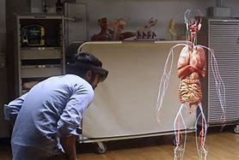
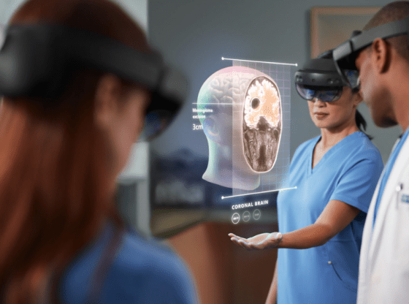

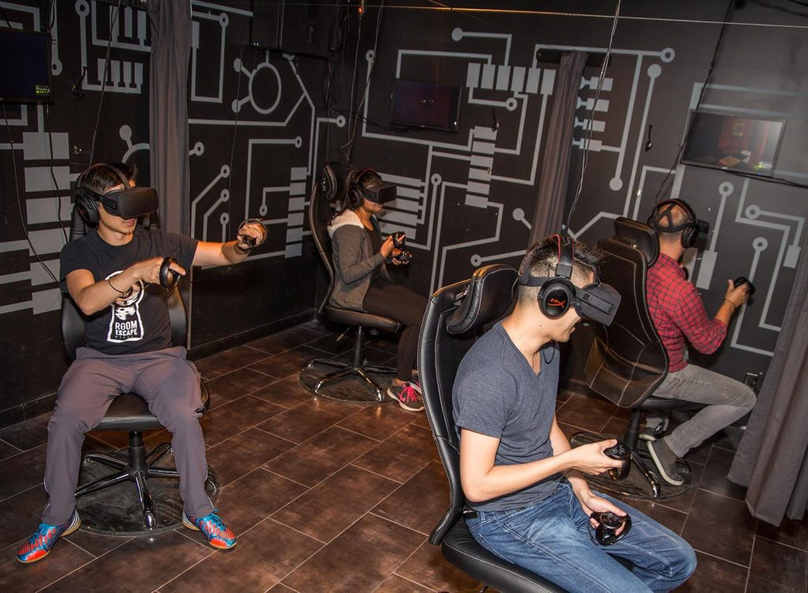
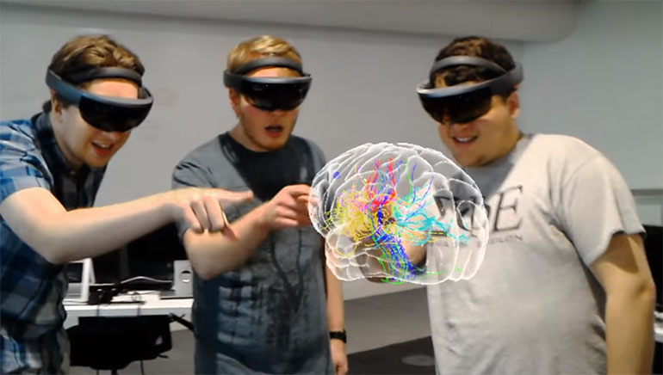
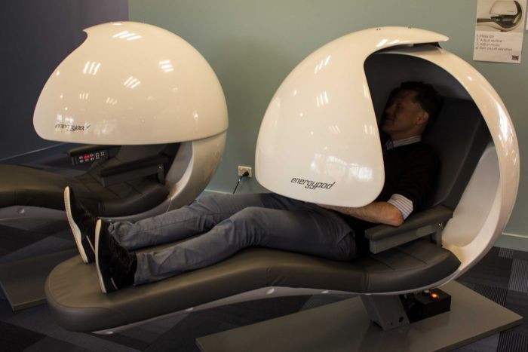
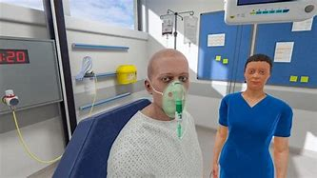
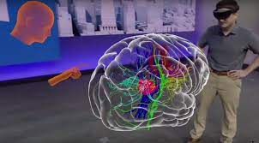
Nickel’s Experience
NERDSMobile
NERDSPod
3.04 Team NERDS

Slide 5

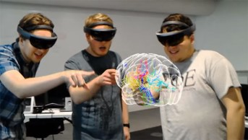


Capture middle and high school students in diverse communities with a compelling experience of nursing
Bring the experience to the students: NERDSMobile, school libraries, and local community center
Eliminates barriers to access to NERDS
Zero cost to students or families
Initially funded through grants designed to enhance career development for Black, African American and Hispanic youth
A 3-month pilot to prove the concept and measure the impact would require a $250,000 investment
Sustained through a subscription services offered to for-profit community colleges and hospitals
3.04 Team NERDS

Slide 6
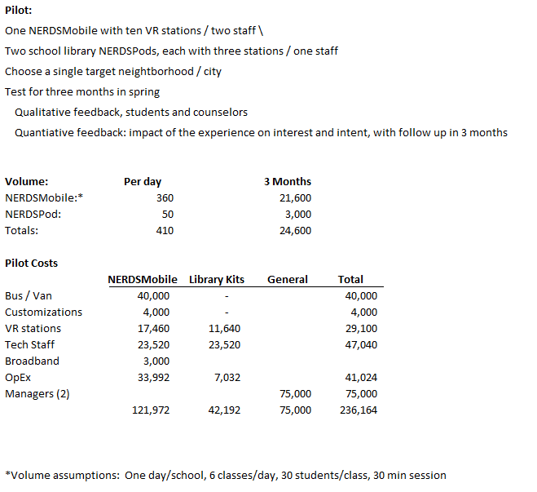
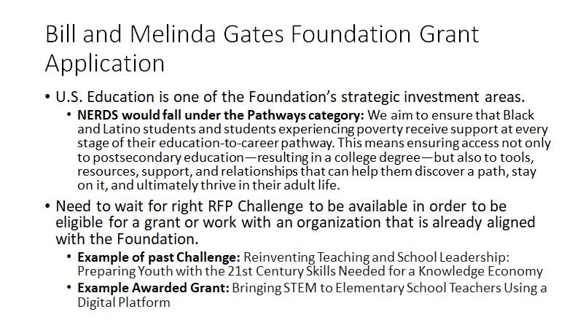
Financials
Funding and Revenue Plan
Target the Gates Foundation Pathway Grant for start-up funding
Partner with VR firms for in-kind donation of VR equipment to lower costs; branding benefit given their target audience
In pilot, partner with two local for profit community colleges with nursing program
Offer the NERDSMobile on a subscription basis
Per-day cost of $1,000, minimum five day
Benefit to them is a lower cost recruitment channel that offers greater market reach
Competition is diffuse
3.04 Team NERDS

Slide 7
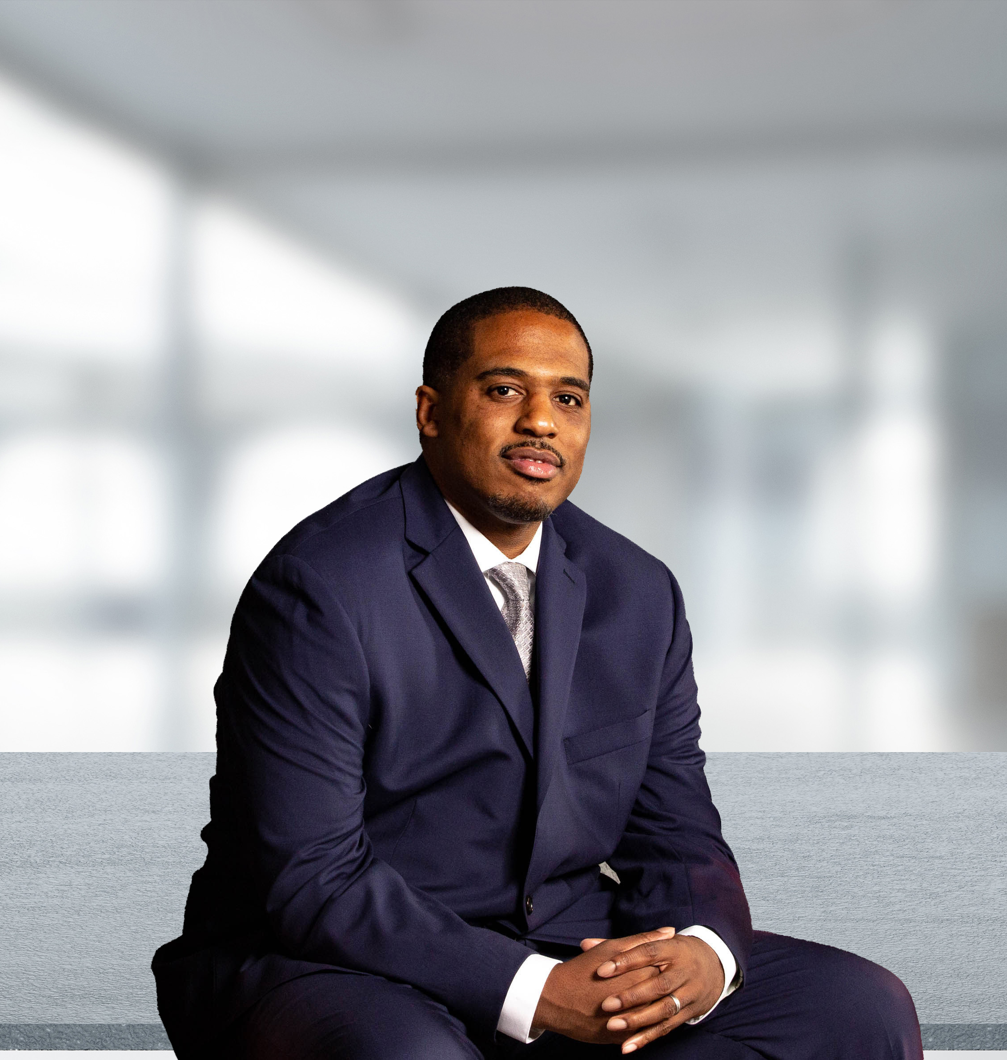
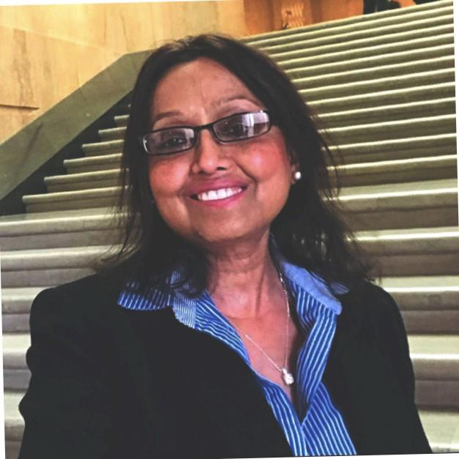
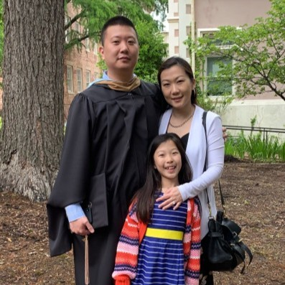
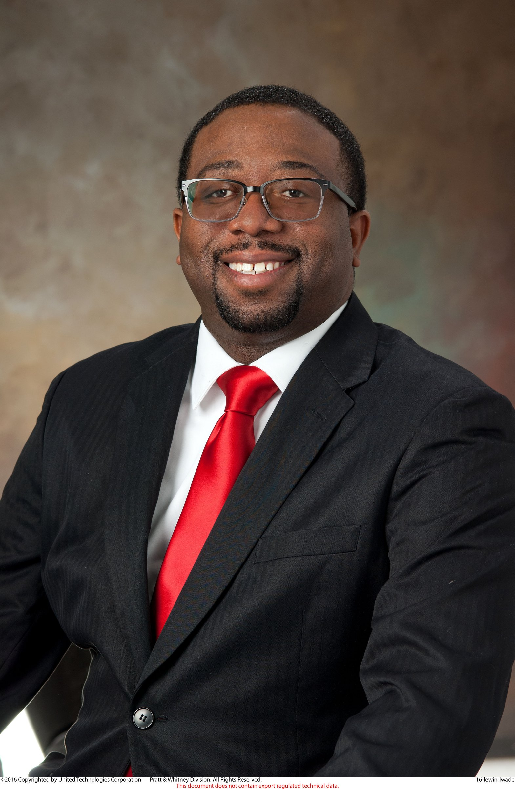
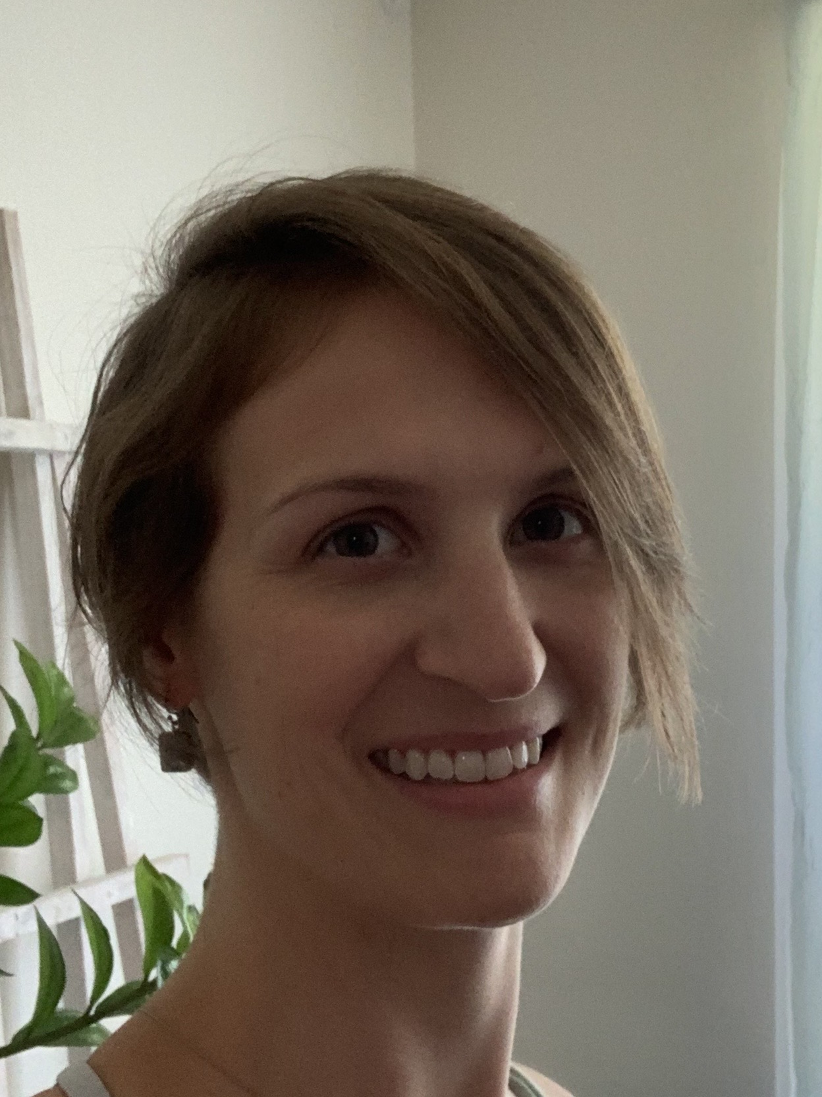
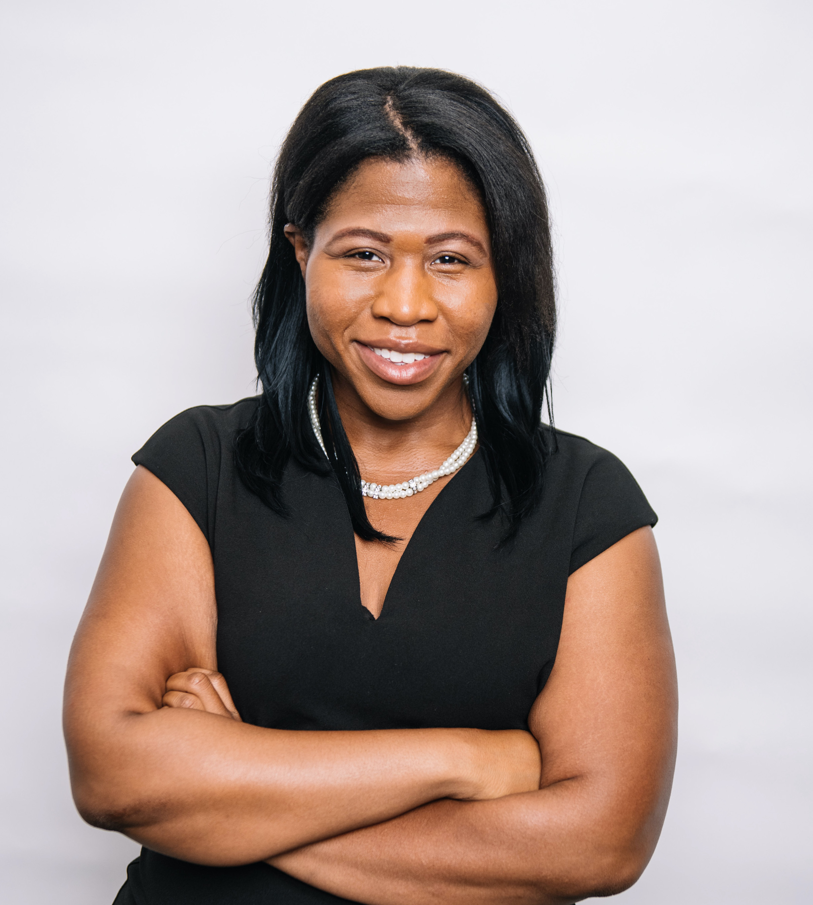
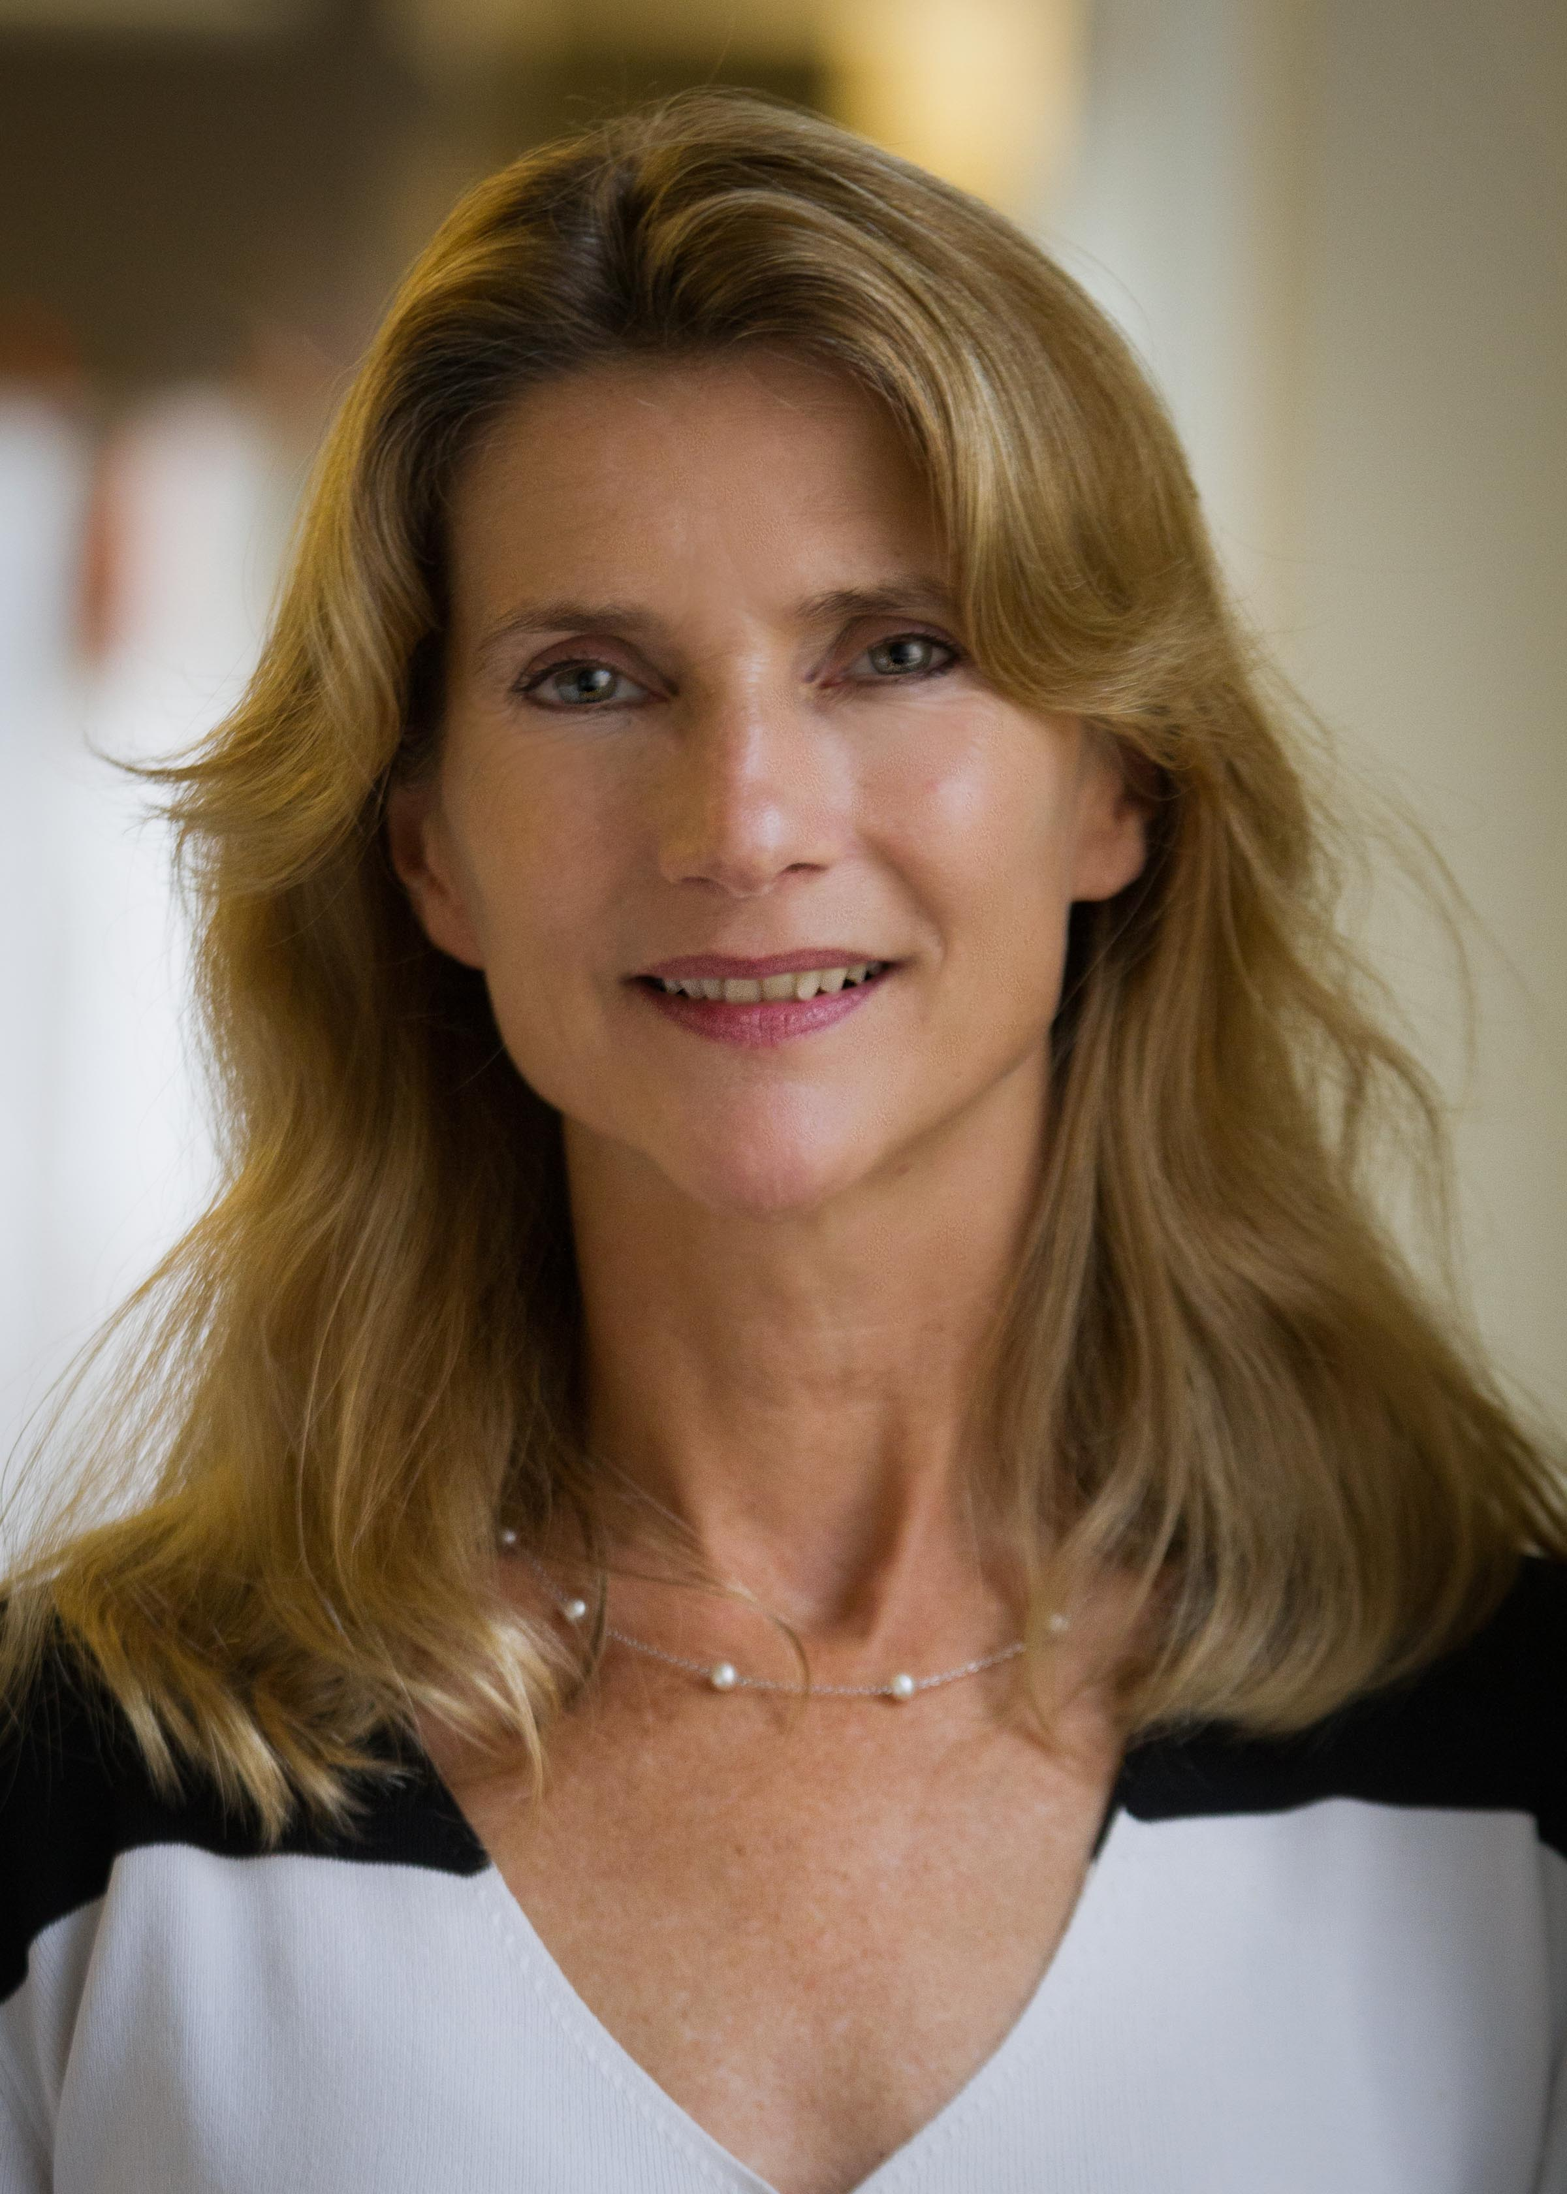
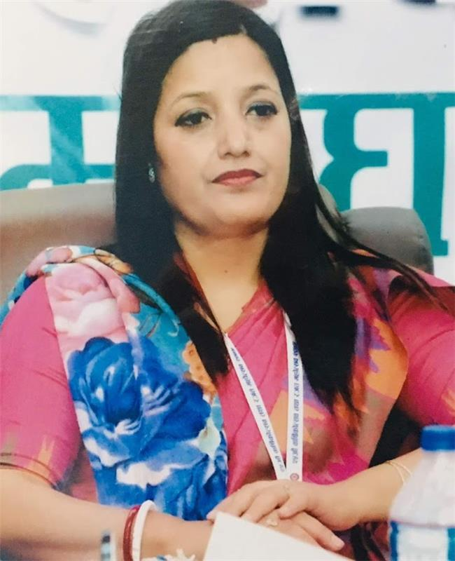
NERDS TEAM has over 150 years of experience
Tony Ellis is a technology leader with an innovative and business mindset adept in creating impeccably architected, cost-effective, market-leading, industry-standard solutions for organizations of any size. As a Principal Cloud Solutions Architect at Microsoft, Tony leads a team of developers, engineers, and operational resources to help an organization achieve more with cloud solutions built on DevOps methodologies. His architect specializations include over 20 years’ experience focusing on datacenter modernization, while driving organizations to expose how they can do everything we do today faster, more scalable, more agile, and more efficient.
Maqsuda Kabir, RN Consultant/Frontend Engineer. I have been an RN for over 25 years in varied specialties. Recent career pivot to becoming a Frontend Engineer. This is my very first Nurse Hackathon experience and absolutely loving it!
Ted Kim is a Microsoft Cloud Solution Architect with 15 years of experience in the Information Technology and Healthcare Industry. He holds an MBA from the University of North Carolina Chapel Hill Kenan-Flagler Business School where he focused his studies on leadership, analytics, and finance and is currently finishing his second undergraduate degree in Computer Science at Oregon State University.
L'Wade Lewin is currently a Material Manager, has over twelve years’ experience within project and risk management, engine assembly, validation testing, labor and budget planning, and engineering design. My academic credentials include a B.S in Aerospace Engineering from Tuskegee University as well as an MBA from the Fox School of Business at Temple University
Shaina Roe, RN is a new grad RN with over 2 years of experience on a telemetry/dialysis floor at a small community hospital. She is currently working on her BSN.
Mary Rose Saint-Cyr is currently a nursing student at MGH Institute of Health Professions located in Boston, MA. She has over 7 years of experience managing grant-funded programs that help increase the number of minorities in the health professions by exposing first-generation, underrepresented, and economically disadvantaged students to the field of medicine. Ultimately, she wishes to serve as a psychiatric nurse practitioner and continue to champion healthcare workforce diversity initiatives.
Lisa M. Stapleton brings 20+ years leadership experience in sales, marketing and customer success in technology firms, with a demonstrated ability to drive business outcomes.
Pramila Thapa, RN has B.Sc Nursing, M.Sc Nursing, Master in Public Administration, Bachelor of Education. Regarding work experiences: Nursing Education Development & Administration consultant & Hospital development and administration consultant
3.04 Team NERDS

Slide 8

What is NERDS?
Nurse Escalator Recruitment Delivery System
NERDS uses virtual reality to simulate engaging, immersive, relevant experiences for potential candidates to explore nursing as a career.
Team-based, “Escape room” scenarios (from entry level to executives, "C-Suite"), to be able to connect to people doing the job I am curious about.
Middle and high school students can schedule virtual reality experiences demonstrating the variety of nursing specialties – from cruise ship nurse to army nursing to nursing informatics – and scenarios (e.g., ER/ICU).
NERDS brings to life the expanded array of options available for nurses, showing people who look like me.
NERDS brings these experiences to students where they are: schools and community centers via a NERDSMobile or NERDSPods.
3.04 Team NERDS
Notes:
Reference All of Us Bus
Career coaching
Office hours
Lower the intimidation factor of STEM, raise the inspiration factor of Nursing
Leverage appeal of nursing to males: critical thinking, fast pace, physical, autonomy, highly technical/specialized skill set, career advancement, flight nursing, military nursing, informatics
Target middle and high school students

Slide 9
Bill and Melinda Gates Foundation Grant Application
U.S. Education is one of the Foundation’s strategic investment areas.
NERDS would fall under the Pathways category: We aim to ensure that Black and Latino students and students experiencing poverty receive support at every stage of their education-to-career pathway. This means ensuring access not only to postsecondary education—resulting in a college degree—but also to tools, resources, support, and relationships that can help them discover a path, stay on it, and ultimately thrive in their adult life.
Need to wait for right RFP Challenge to be available in order to be eligible for a grant or work with an organization that is already aligned with the Foundation.
Example of past Challenge: Reinventing Teaching and School Leadership: Preparing Youth with the 21st Century Skills Needed for a Knowledge Economy
Example Awarded Grant: Bringing STEM to Elementary School Teachers Using a Digital Platform
3.04 Team NERDS

Slide 10
Appendix
3.04 Team NERDS

